Slide 1
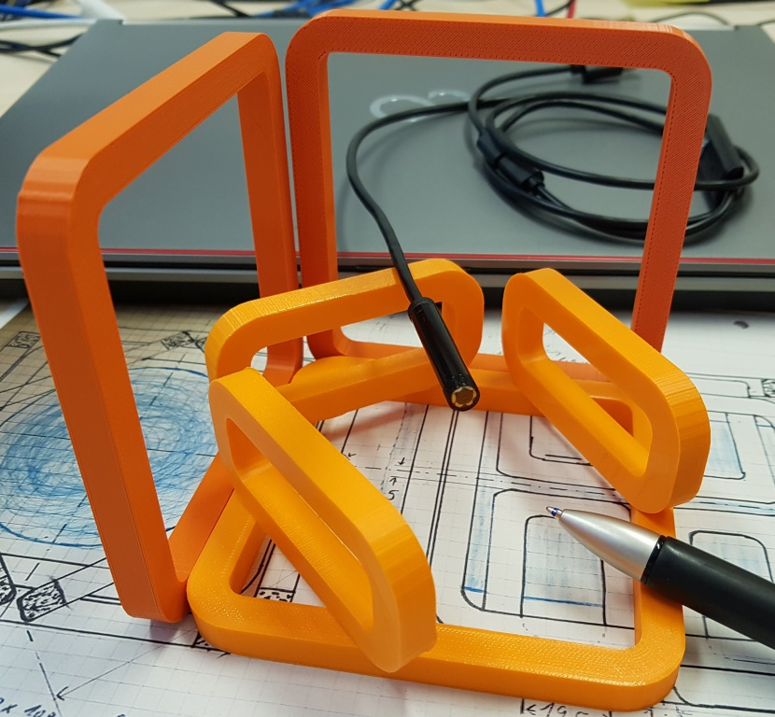
Magnetic Object Mover
MOMo
Status

Slide 2
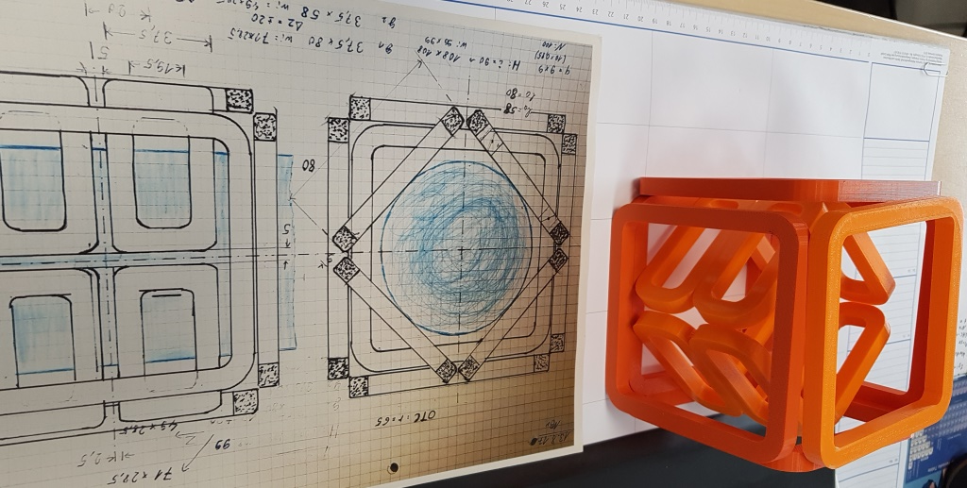
Contents:
Motivation
Introduction
Basic Principals
Forces and torques by magnets
Biot-Savart-law
The 2A Magnet System
1st concept
Building
Conclusion 2A Magnet System
The 15A Magnet System
Planning and calculation
Coil Production
Mounting
Endoscope Components
Endoscope
Drilling Endoscope
Programming and Experiments
Programming and Components
Simple Rotation
System Layout
Software
Summary

Slide 3
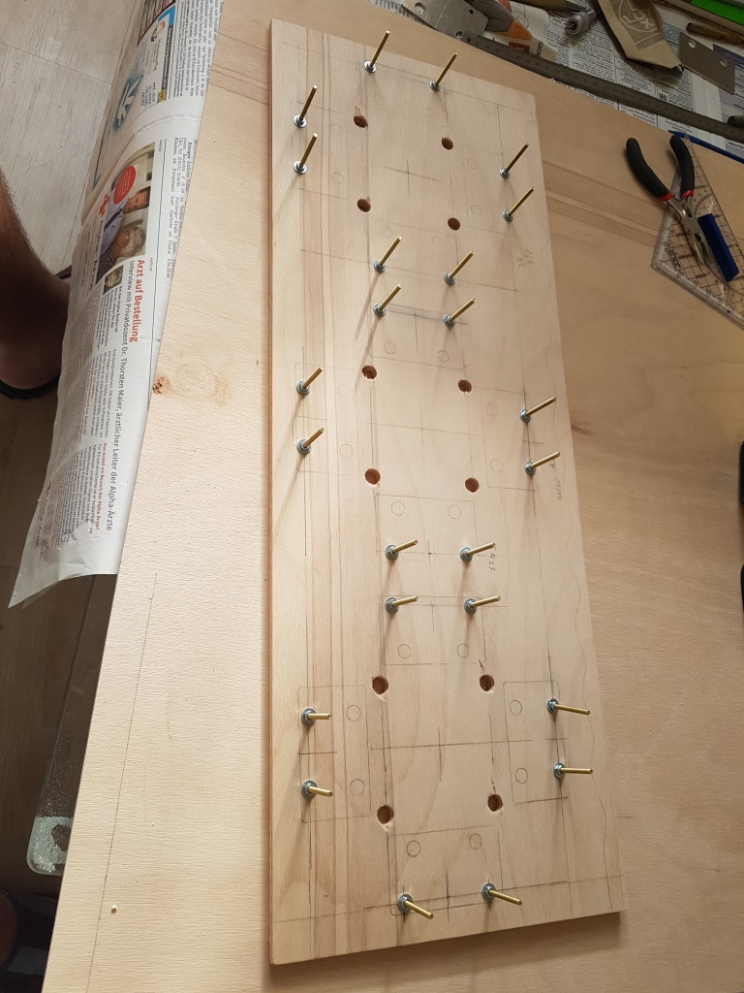
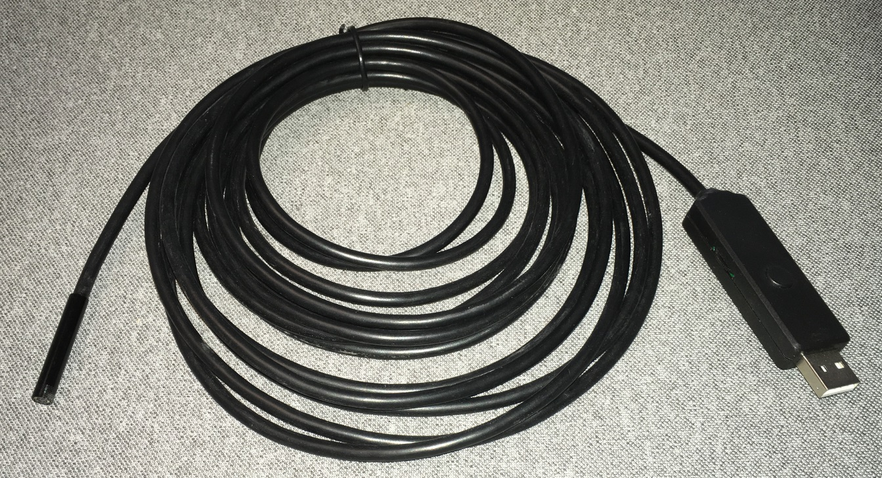
(1) Motivation
Experiments and Goals
Steering of “capsules” shown by Siemens Healthcare ~2010 in clinical studies
Not shown: Is a “drill” system feasible?
Idea: Work on a simple coil set to demonstrate “drill” systems
Enabler: Today we have access to cheap USB Endoscopes (~20€), no need to get/ manufacture “capsules”

Slide 4
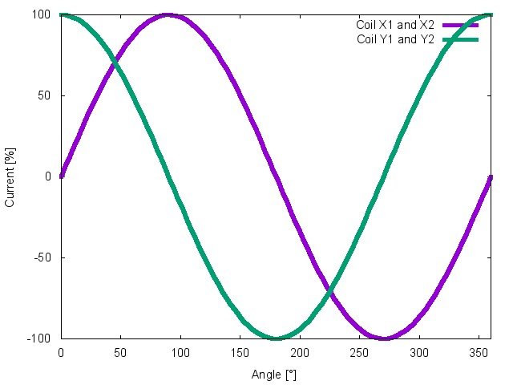
(2.1) Introduction of Basic Principals
Magnet System
This device will rotate as a synchro-motor if the outer coils generate a sinusoidal field.
Apply magnetical force to an object instead of a rotor
Rotation of the magnetic field
4 Helmholtz Coil System are used as stator
Y2
B-Field
X1
X2
Y1

Slide 5
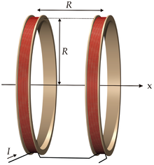
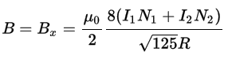
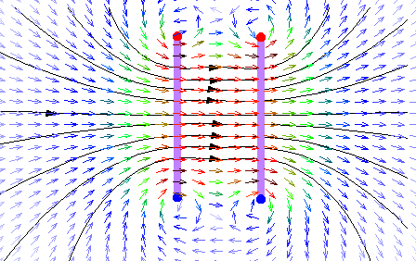
(2.2) Intermezzo: “Helmholtz coils”
Classical physics demonstrators
Well known
Current direction in coils: parallel
Provide homogenous fields on axis
No need for numerics: Can be understood analytically
Field: proportional I*N/R !
I
I
R [mm], I [A]: B[mT] = 0,9 * 2* I * N / R
Simulated field lines of a Helmholtz coil
Literature: German Wikipedia, Keyword “Helmholtz –Spule”, visited on 22.06.2018

Slide 6
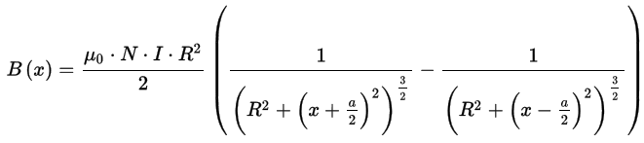
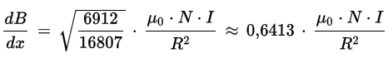
(2.3) Intermezzo: “Anti Helmholtz” or “Maxwell” coils
d_{opt} = sqrt(3)*R
Helmholtz setup
Coil-coil distance different
Current direction in coils: anti-parallel
Provide linear gradient
No need for numerics: Can be understood analytically
Gradient: proportional I*N/R² !
I
I
R [mm], I [A]: g[mT/m] = 0,641 * I * N / R²
Simulated field lines of a Helmholtz coil
Literature: German Wikipedia, Keyword “Helmholtz –Spule”, visited on 22.06.2018

Slide 7
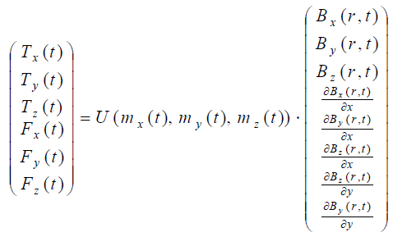
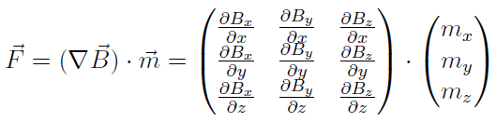
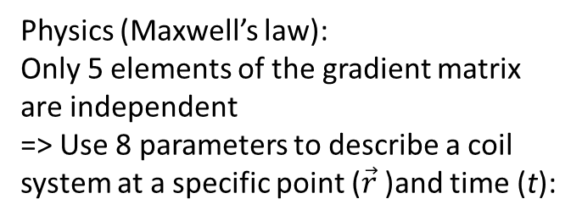
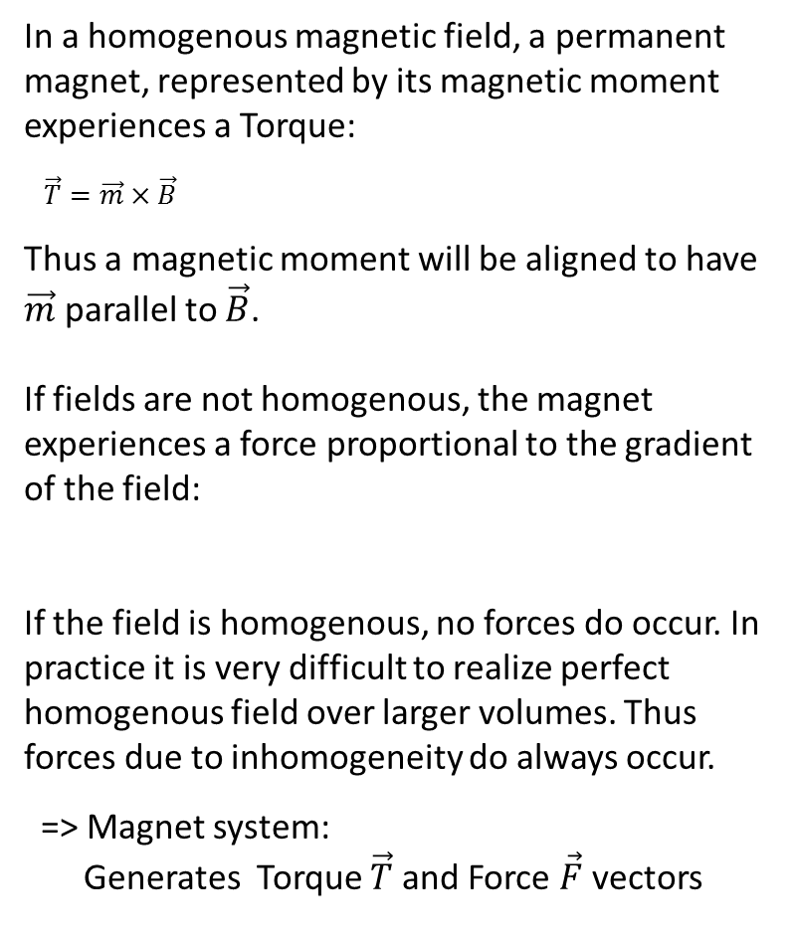
(2.4) Forces and torques by magnets
In a homogenous magnetic field, a permanent magnet, represented by its magnetic moment experiences a Torque:
$\vec{T}=\vec{m}×\vec{B}$
Thus a magnetic moment will be aligned to have $\vec{m}$ parallel to $\vec{B}$.
If fields are not homogenous, the magnet experiences a force proportional to the gradient of the field:
If the field is homogenous, no forces do occur. In practice it is very difficult to realize perfect homogenous field over larger volumes. Thus forces due to inhomogeneity do always occur.
=> Magnet system:
Generates Torque $\vec{T}$and Force $\vec{F}$ vectors
Physics (Maxwell’s law):
Only 5 elements of the gradient matrix are independent
=> Use 8 parameters to describe a coil system at a specific point ($\vec{r}$)and time (t):
The above vector formulation allows to compute the torque/force vector as a function of the orientation of m.
Each single coil contributes 8 parameters, depending on its geometry and applied current.
Literature: Henrik Keller, “Methode zur magnetischen Steuerung schwimmender endoroboter”, Dissertation, Karlsruhe, 2012

Slide 8
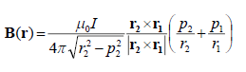
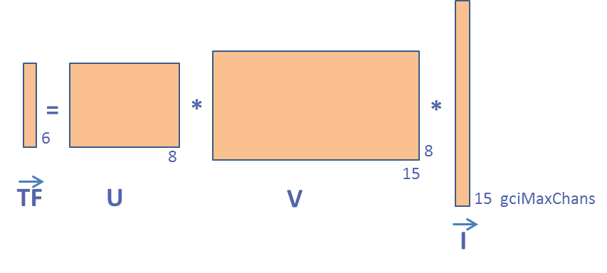
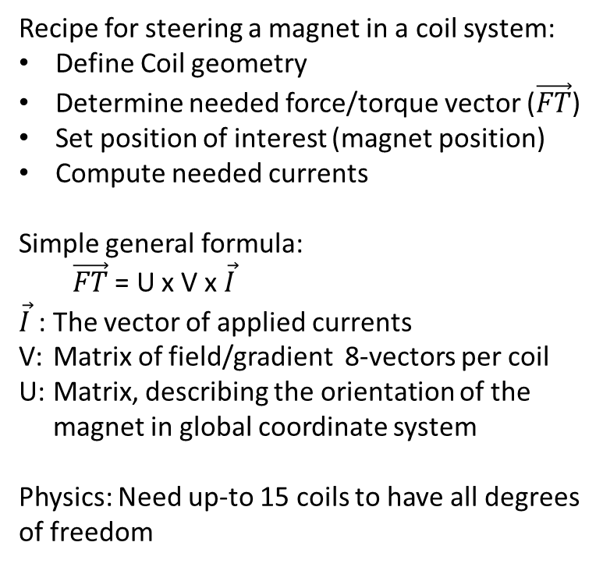
(2.5) Introduction Biot-Savart-law
Recipe for steering a magnet in a coil system:
Define Coil geometry
Determine needed force/torque vector ($\vec{FT}$)
Set position of interest (magnet position)
Compute needed currents
Simple general formula:
$\vec{FT}$ = U x V x $\vec{I}$
$\vec{I}$ : The vector of applied currents
V: Matrix of field/gradient 8-vectors per coil
U: Matrix, describing the orientation of the magnet in global coordinate system
Physics: Need up-to 15 coils to have all degrees of freedom
V- Matrix:
Describe coils by wires
Use Biot-Savart-law to compute field of each wire at the position of interest:
Differentiate numerically for the gradient-terms.
V-Matrix at any given point is a constant property of the magnet system
=> Nasty theory, discussed after two more intuitive approaches on further examples

Slide 9
(3.1) 2A system, 1st concept
Geometry and printed coil dummies of a 1:8, 2A system (1)
Base: Rectangular Helmholtz-coils
Initial goals:
Understand theory
Validate geometry
Measure (?) fields
Focus: Gradients !
Coil 1
Example of a “V-Matrix”:
Coil 1

Slide 10
(3.2) 2A system, 1st concept
6 HeHo coils
8 gradient coils
Units of V-matrix: mT/100A field and mT/m/100A for gradients
(Attention: Large values are per 100A: 40mT/100A*2A=~0,8mT) Example gives gradient in x and field in Z
Multiply matrix with current vector to get field and gradients
First 6 coils: Helmholtz coils (HeHo’s)
Hx: Field in x-direction
Hy: Field in y-direction
Hz: Field in z-direction
Using only the 6 HeHo’s
Arbitrary field (strength and direction) possible
Only gradients (forces) along Coordinate axis possible (∂B_{x}/∂x, ∂B_{y}/∂y, ∂B_{z}/∂z)
No mixed-term gradients possible (physics)
Only 2 independent gradients possible
∂B_{z}/∂z = -∂B_{x}/∂x - ∂B_{y}/∂y

Slide 11
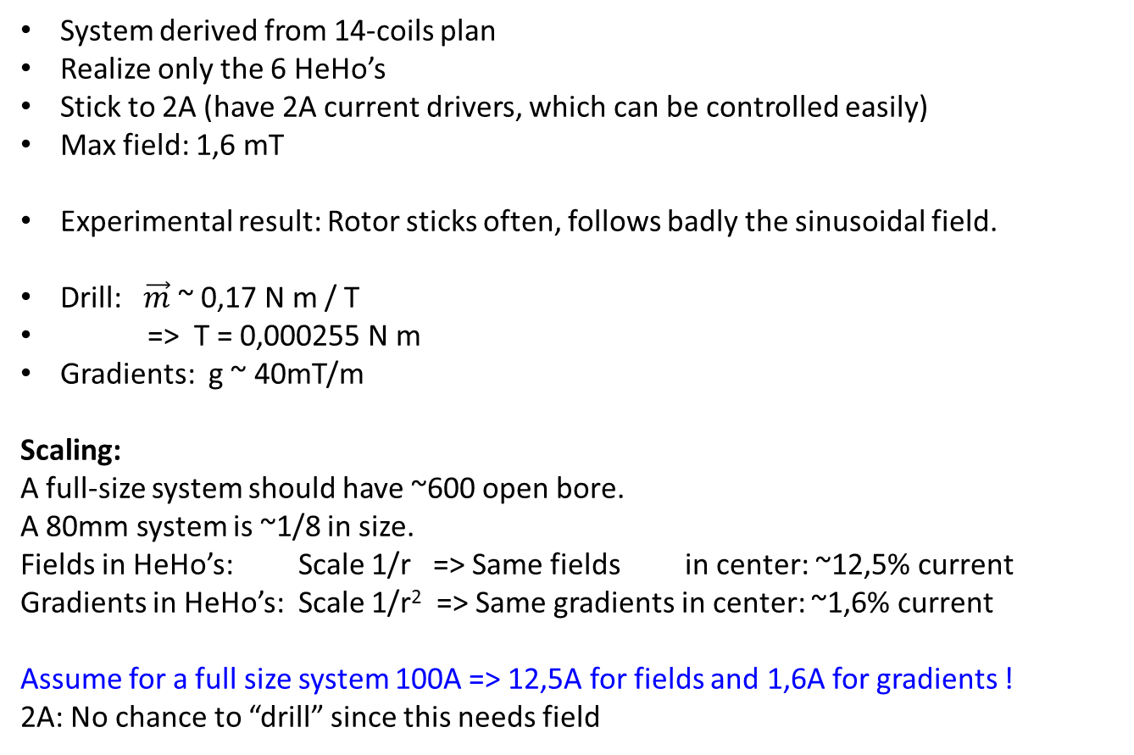
(3.3) 2A system, planning and basic data
System derived from 14-coils plan
Realize only the 6 HeHo’s
Stick to 2A (have 2A current drivers, which can be controlled easily)
Max field: 1,6 mT
Experimental result: Rotor sticks often, follows badly the sinusoidal field.
Drill: $\vec{m}$ ~ 0,17 N m / T
=> T = 0,000255 N m
Gradients: g ~ 40mT/m
Scaling:
A full-size system should have ~600 open bore.
A 80mm system is ~1/8 in size.
Fields in HeHo’s: Scale 1/r => Same fields in center: ~12,5% current
Gradients in HeHo’s: Scale 1/r² => Same gradients in center: ~1,6% current
Assume for a full size system 100A => 12,5A for fields and 1,6A for gradients !
2A: No chance to “drill” since this needs field

Slide 12
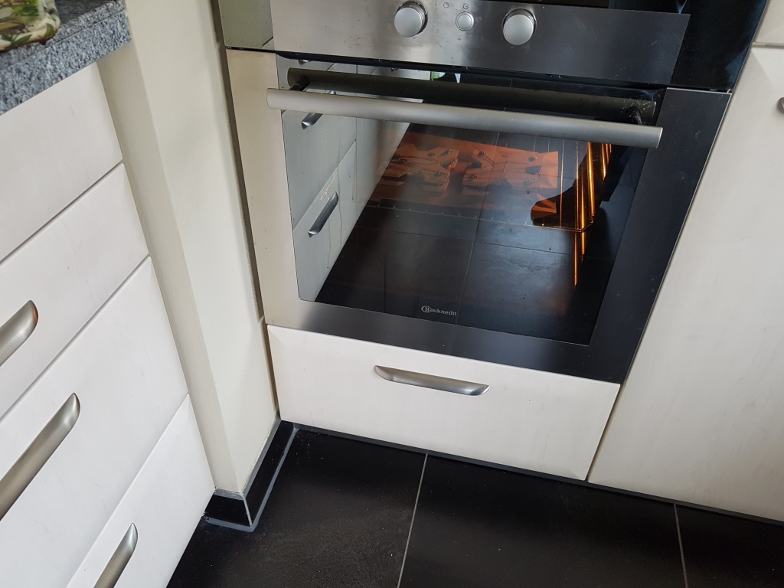
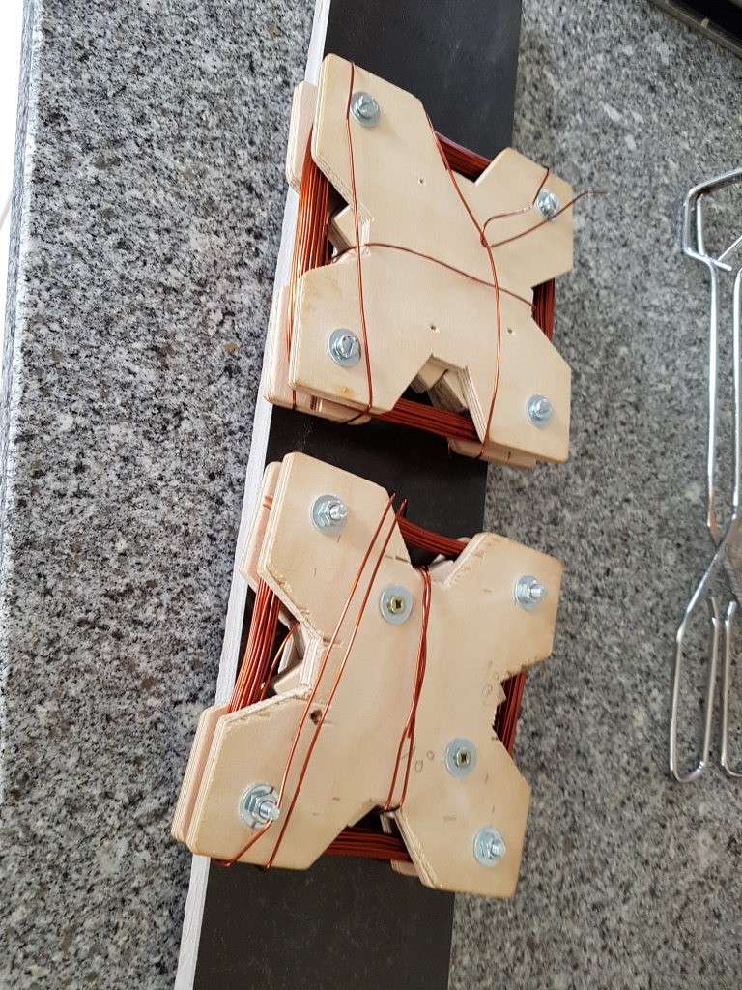
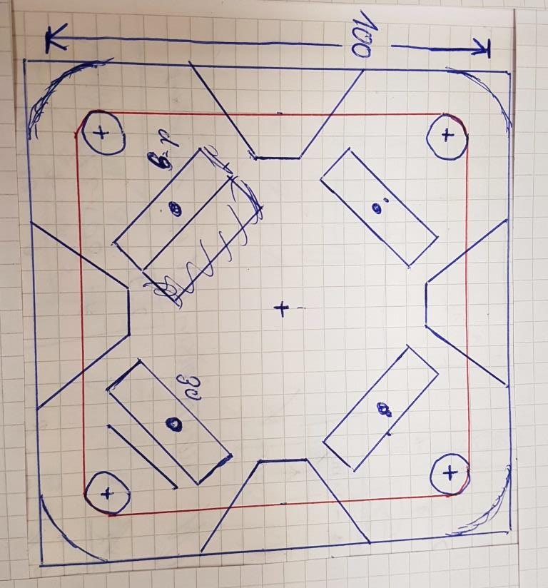
(3.4) First 2A Magnet System
First 2A Magnet System
Self bonding wire (Backlackdraht)
Wire: Ø0,85 mm, 100 windings
Mid of coil: 100mm x 100mm
9mm x 9mm coil cross section
Mechanical layout coils-winder

Slide 13
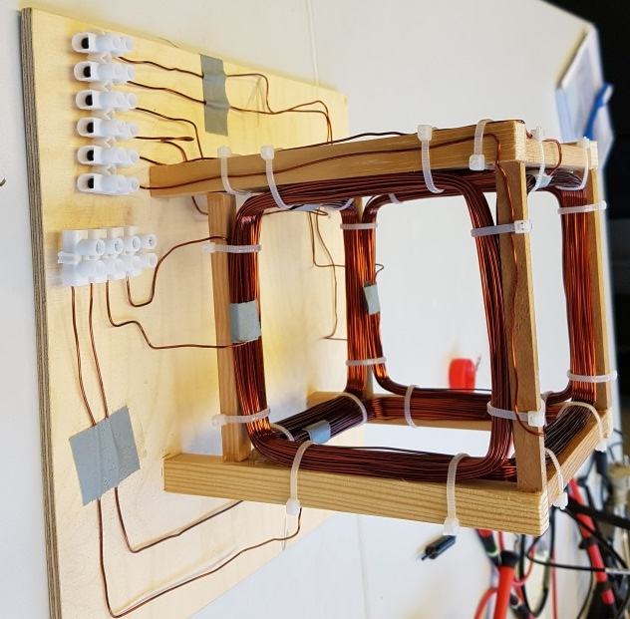
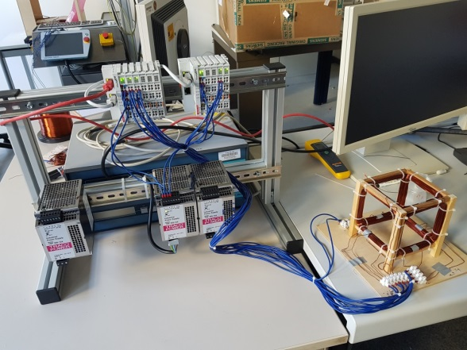
(3.5) Conclusion 2A Magnet System
6 Coil 2A Magnet System
6 Helmholtz Coils
To control the coil current a PLC was used
Maximal current 2A (due to the thermal load)
1,5 .. 1,6mT (lower than V-matrix due to imperfections)
Rotor sticks frequently
Torque too low
Build 15A version

Slide 14
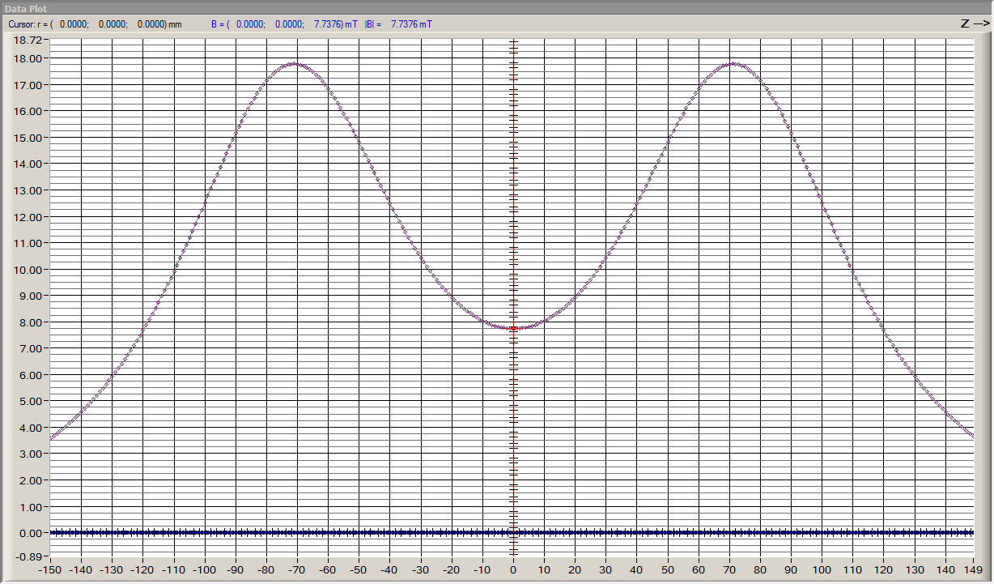
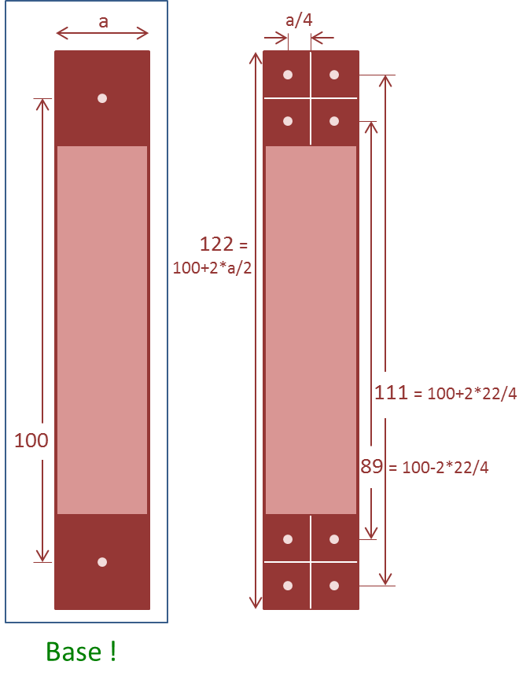
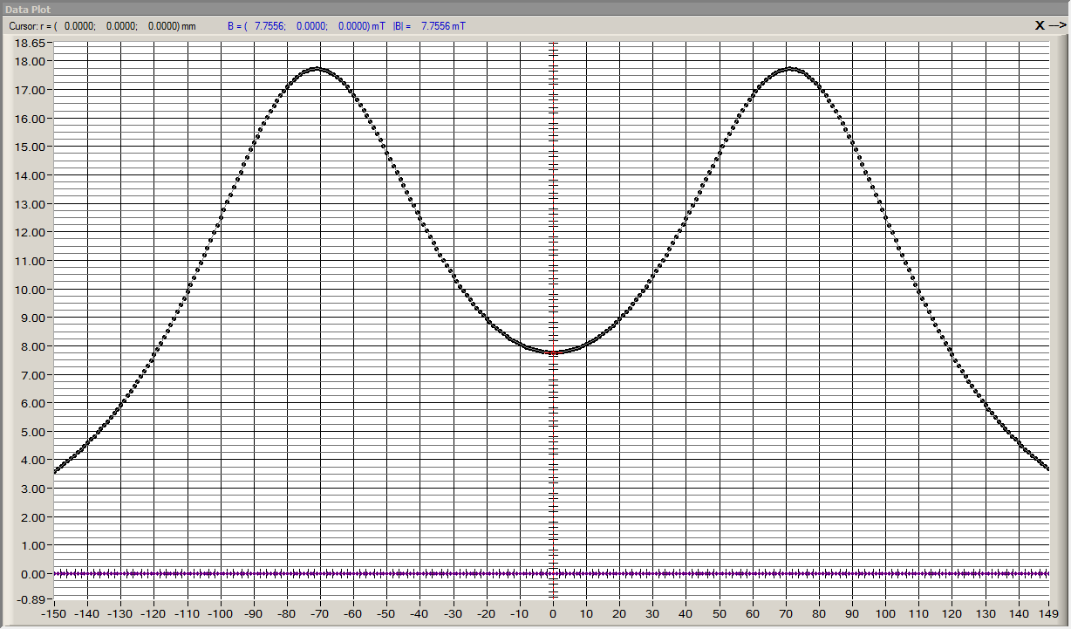
(4.1) 15A Coil planning and calculation
Coil planning:
Goal: 100mm x 100mm “filament” in computation
15A wire (~2mm diameter), 100 windings => 20x200 Cu “Thick => is one filament justified?
Compare computation with 1 and 4 filaments => marginal difference, one is OK
B = 7,74mT 1-wire
B_{x} [mm]
B = 7,76mT 4-wire
x [mm]

Slide 15
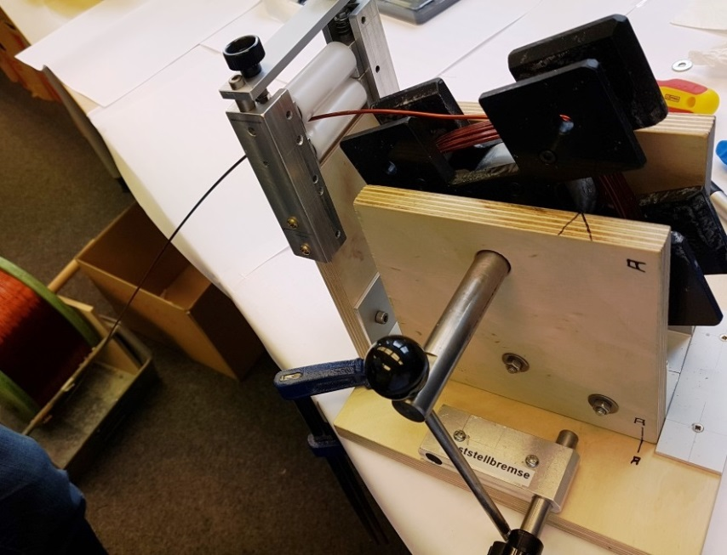
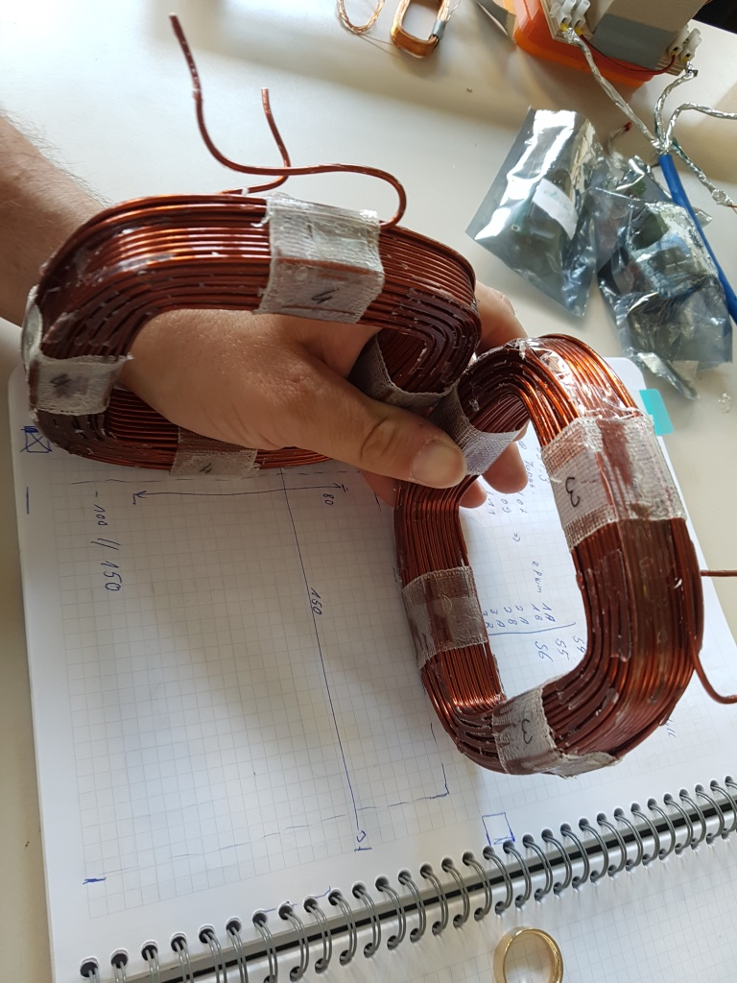
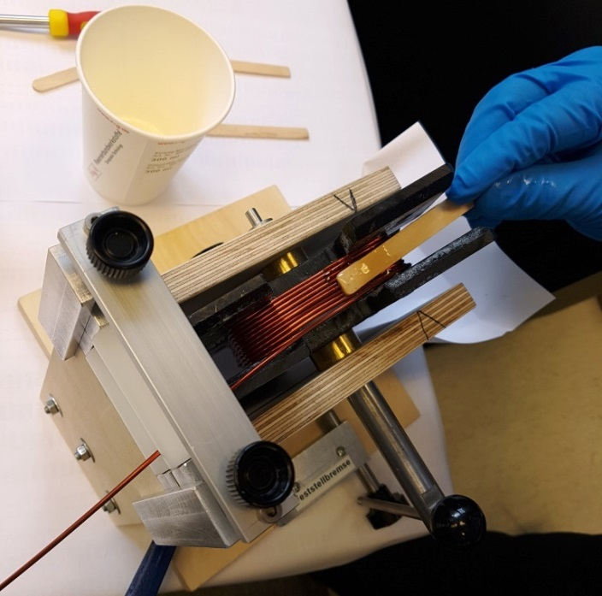
(4.2) 15A Coil Production
Step 1 - Manufacturing
15A Copper Wire Coils have to be glued, to maintain their shape after production
During production the 2mm diameter copper wire has to be bended and fixated
Drying process needs roughly 24h

Slide 16
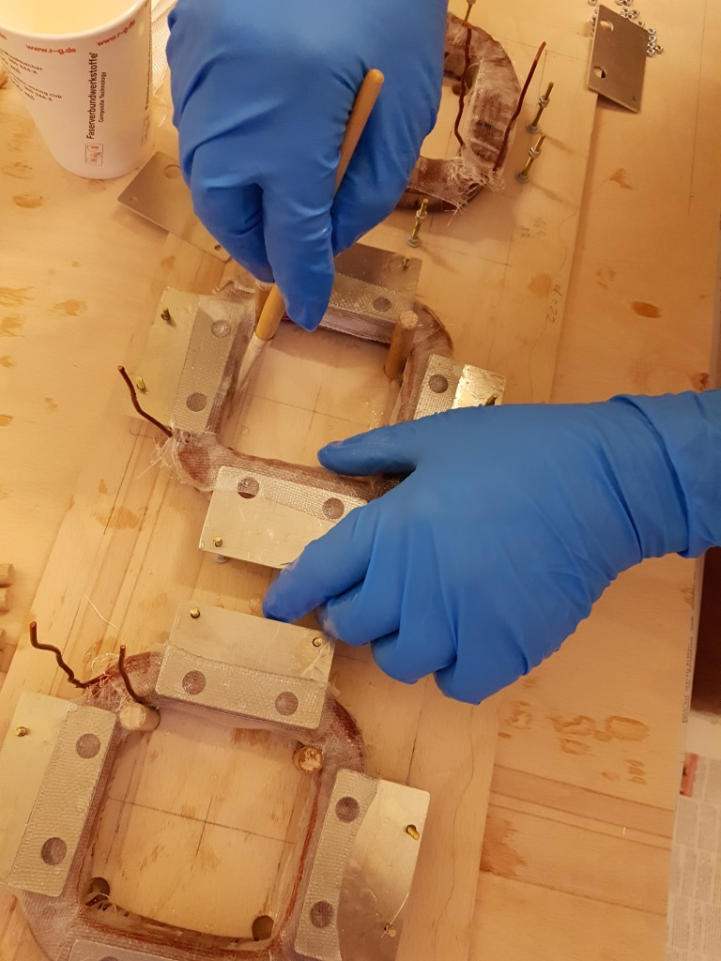
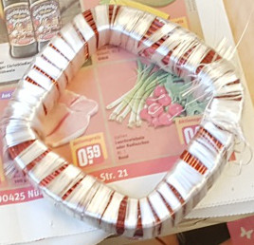
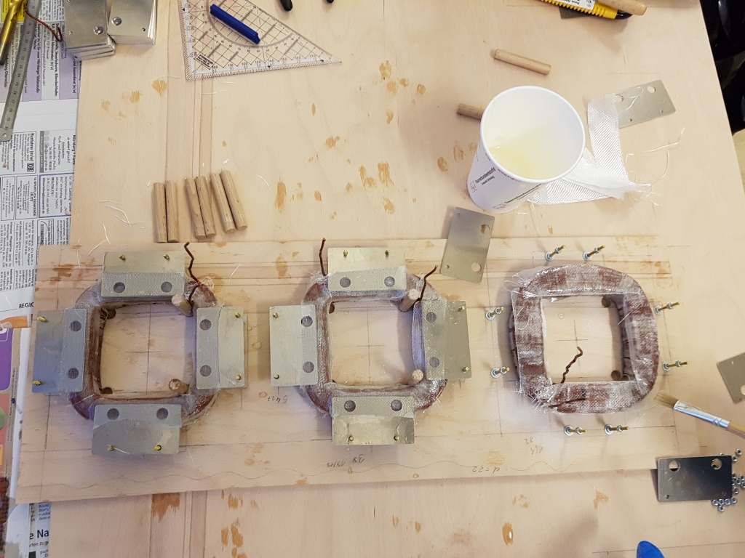
(4.4) 15A Coil Production
Step 2 – Final Steps
Wrap Coils with fiberglass fabric
Placing frame components
Glue both components with coil
Drying process needs roughly 24h again

Slide 17
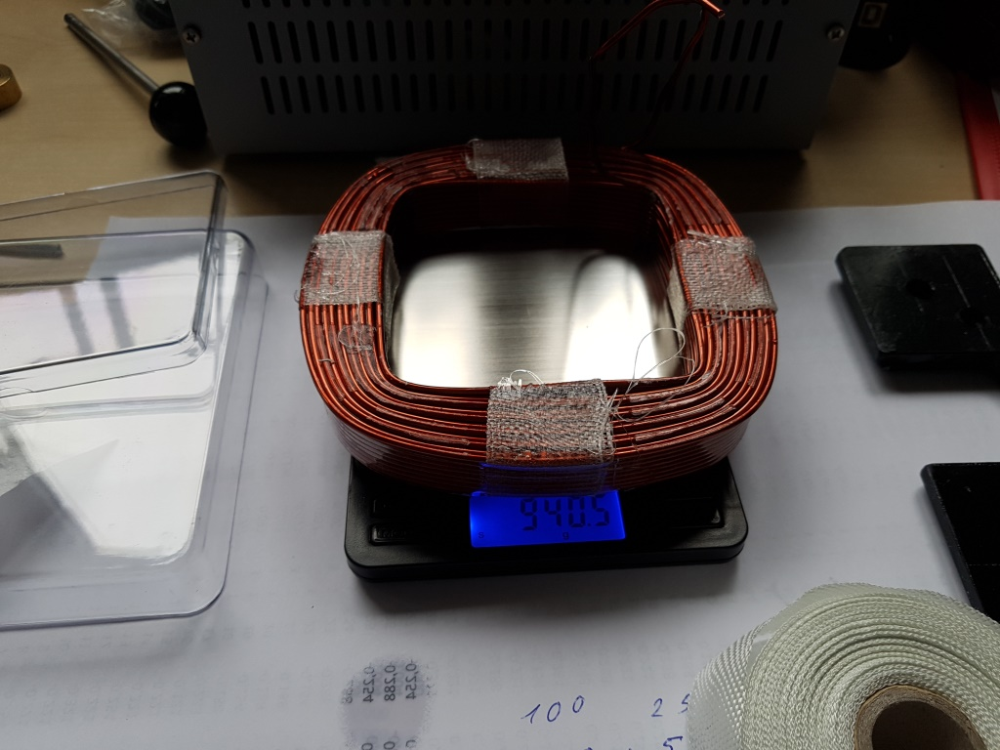
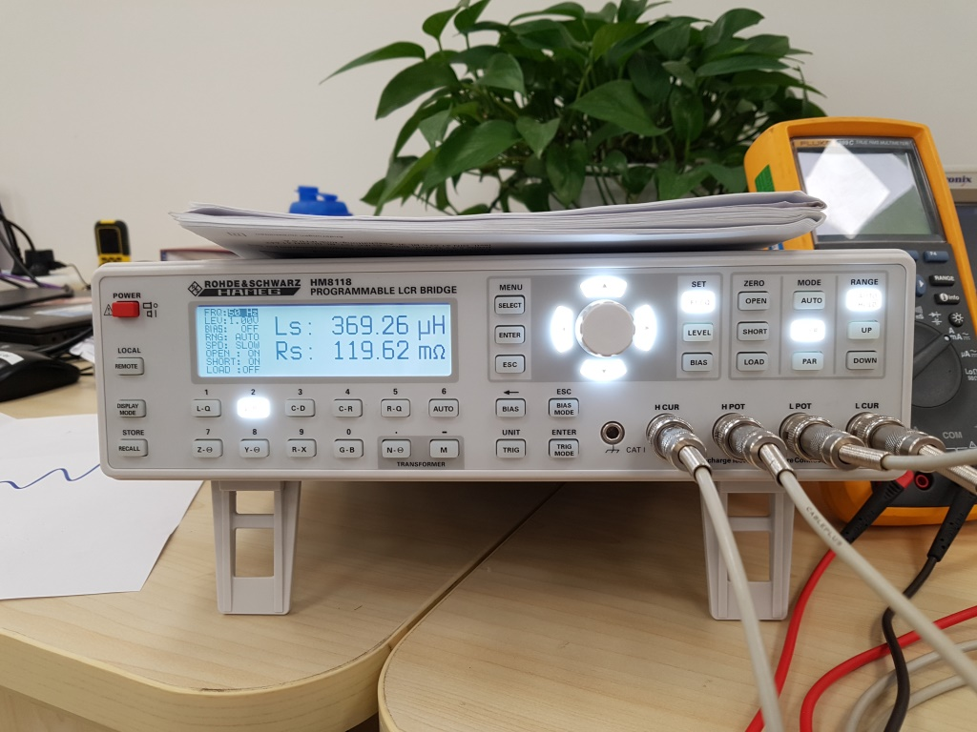
(4.3) 15A Coil – Technical Data
Technical Data of our 15A Coils
940 g copper
100 windings
L = 1,118mH
R = 220 mOhm
Bore diameter 80x80
Test of “CoilZero”, 440g, round

Slide 18
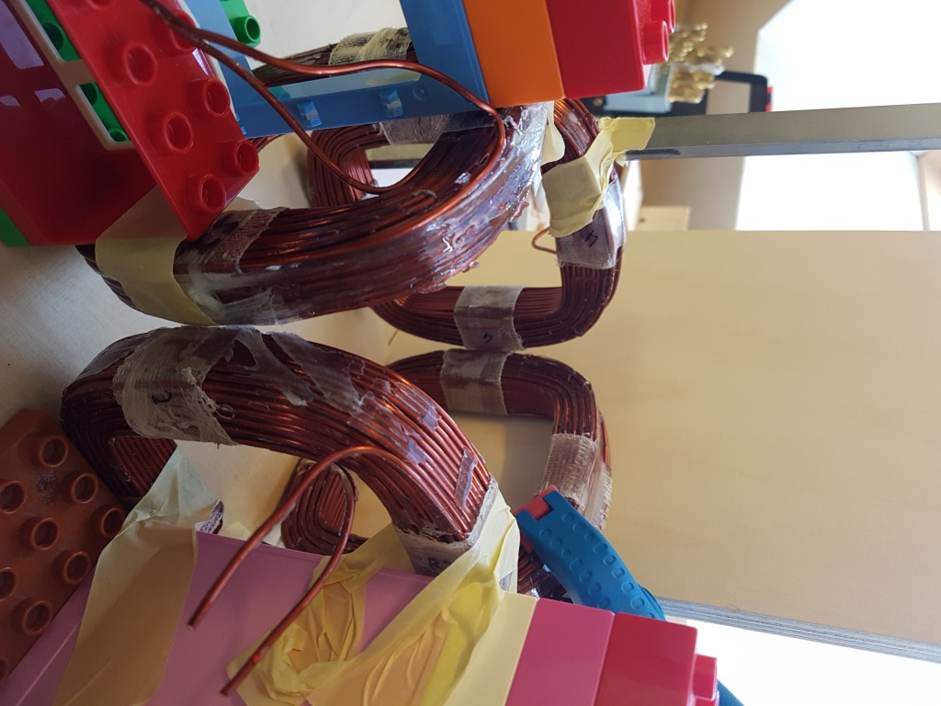
(4.5) New 15A Magnetic System
New Magnetic System
6x940 g copper coils
Preliminary setup without frame
→ Frame currently under construction
→ Will be finished soon

Slide 19
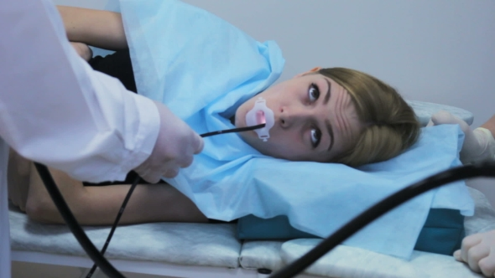
(5.1) Endoscope
Endoscope
Medical Endoscopes base on two characteristics:
Optical camera system taken from an arbitrary point inside a patient
Move the camera to such points by mechanical manipulating of a physical connection between it and patients exterior
Very inconvenient for patients - Although a great improvement over eventual alternative procedures, the application of especially gastroendoscopies and colonoscopies is reported still as highly inconvenient for patients
The ability to mechanically operate in vivo and/or remove samples to the exterior is considered an important but nevertheless optional implementation detail of currently marketed endoscopes. For our experiments we don't take it into consideration for the time being.

Slide 20
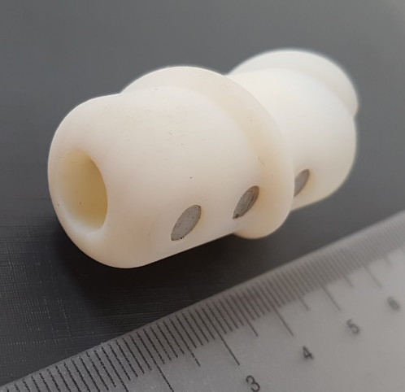
(5.2) Rotor
Rotor
An magnetical object aligns itself with the homogenous but time variant B-field
The Magnetic Axis of the rotor needs to be orthogonal to the intended rotational axis
3D printed rotor head (1) to house magnets in a defined position
Standard Neodymium Magnet (2): NdFeB
Axial magnetized round Magnets
Standard commercially available Magnet price: 2 – 5 EURO
1
2

Slide 21
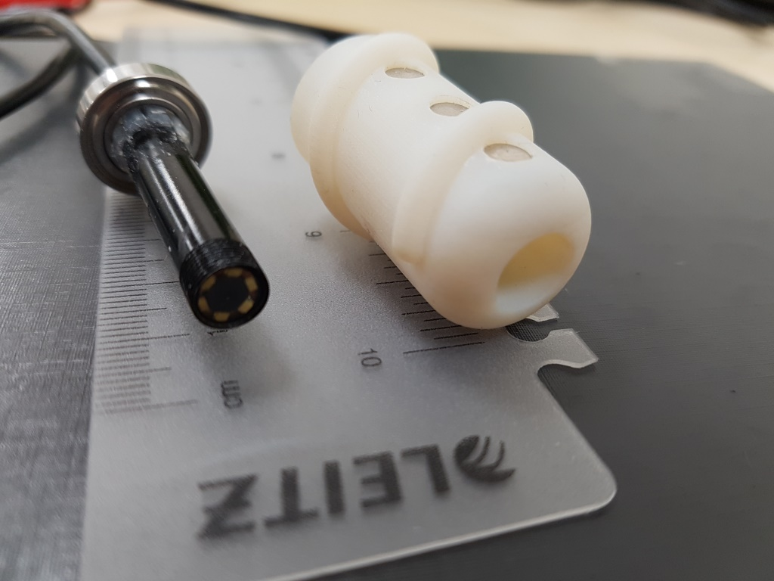
(5.2) Rotor + Endoscope = Drilling Endoscope
Drilling Endoscope
Magnetic field rotates
Rotor head follows the field
Works like a propeller producing propulsion
Bearing between Rotor and Endoscope
Standard USB-Endoscope
Light can be controlled with the integrated LEDs
USB – Universal connection
OS independent
Resolution: VGA
Price: 10 – 15 EURO

Slide 22
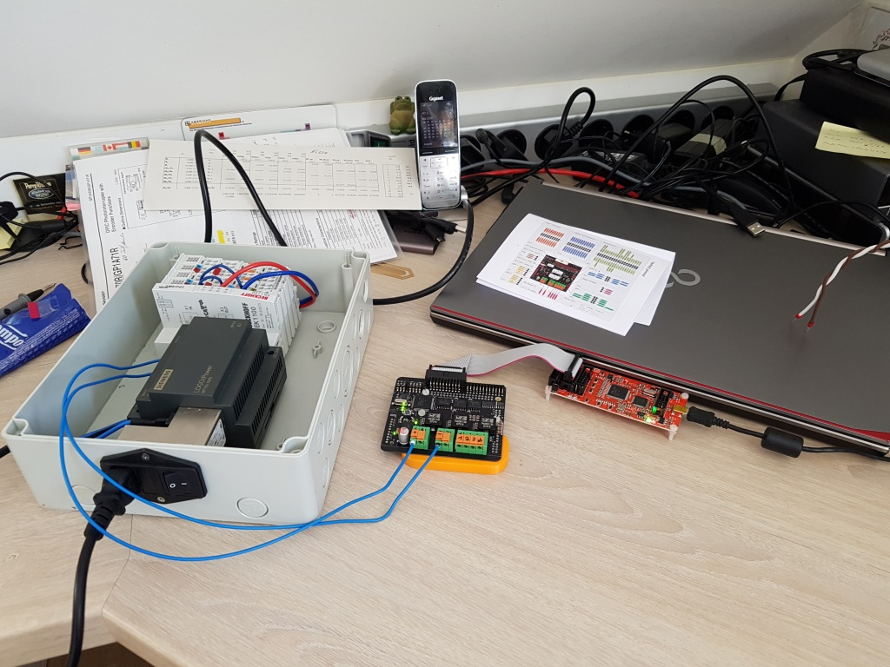
(6.1) MOMo Programming
Tapas programming
Communication between the TAPAS boards via SPI
Piggy-pack on motorware
Controlled by one raspy
Control loop
DC-BUS Current, Voltage Board temp. Error Status, Digital IN

Slide 23
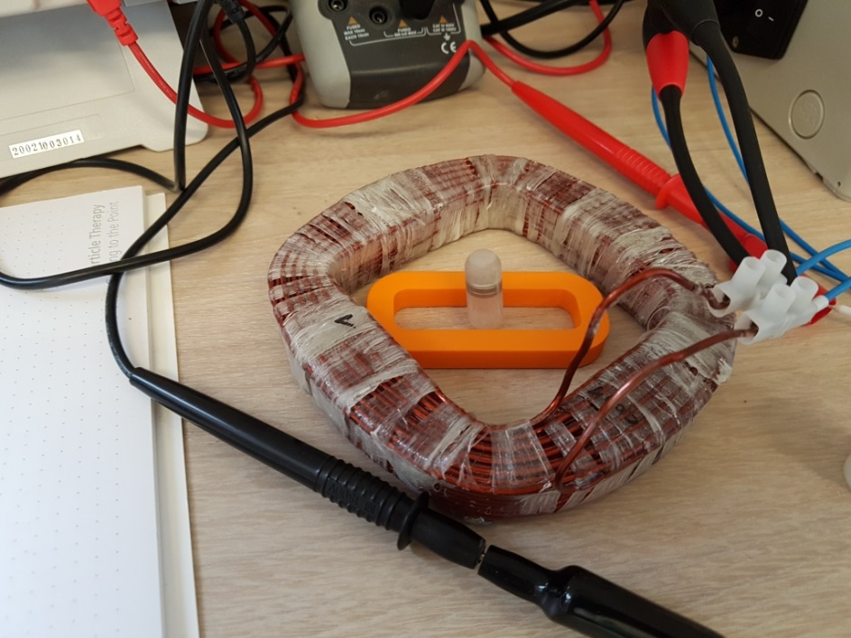
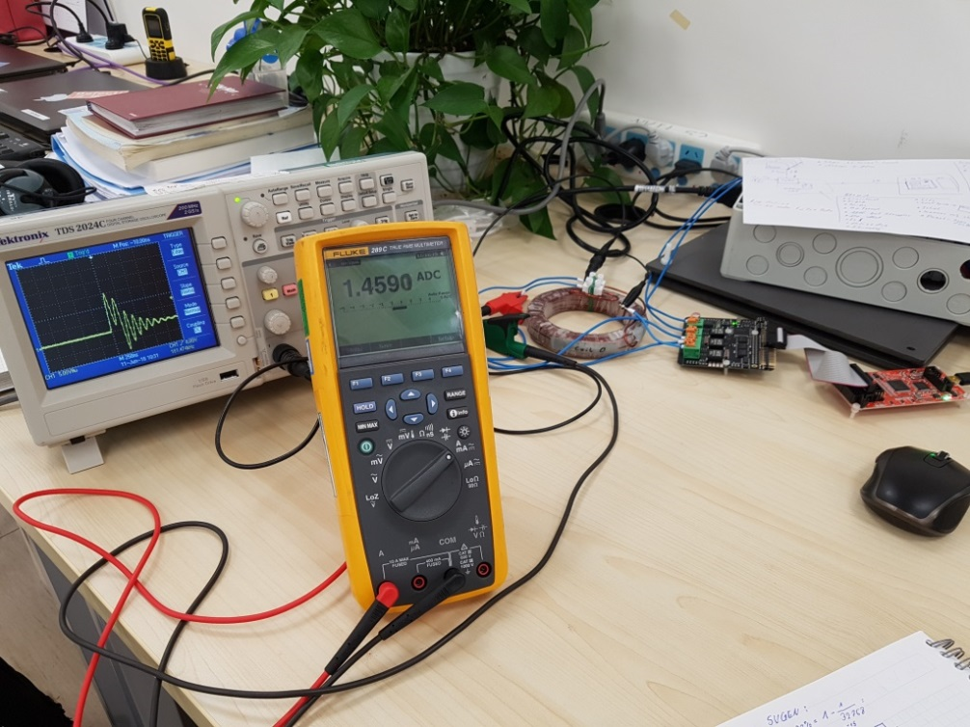
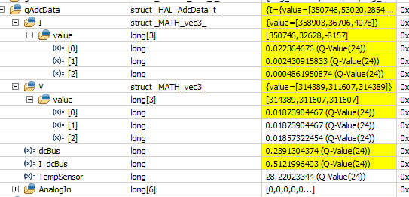
(6.2) MOMo Components
MOMo Components
A) Fluke Multimeter – Current measurement
B) Tapas Boards providing controlled current
C) TAPAS Programmer
D) Coil (here: „CoilZero“, 440g)
E) Magnet used as probe
D
E
A
B
C

Slide 24
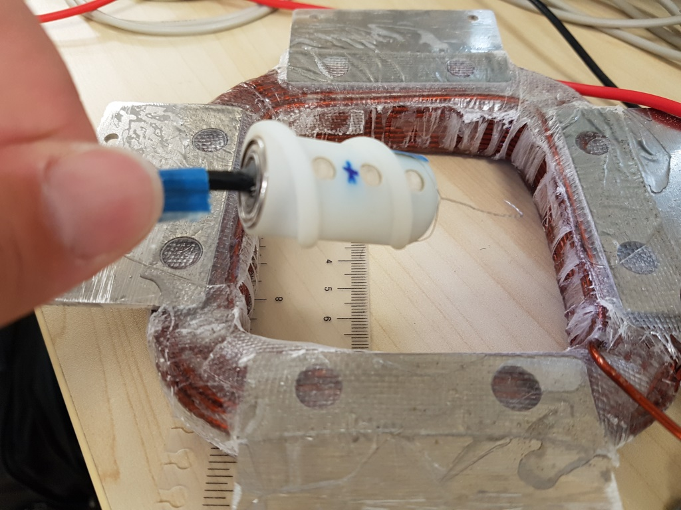
(6.3) MOMo Simple Rotation
With one coil the magnetic field is inverted
„Drilling“ Endoscope turns (speed and angle can’t be controlled with one coil.
TAPAS H-bridge is used to invert coil current
See attached video.

Slide 25
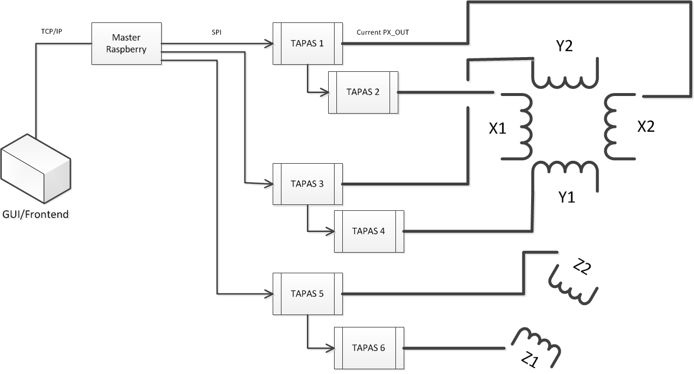
(6.4) MOMo Layout
MOMo Layout
A Raspberry Pi acting as SPI master to multiple TAPAS slaves.
Each TAPAS slave act itself as master for more TAPAS slaves as desired.
Each TAPAS controls current output to only one coil (as of now).

Slide 26
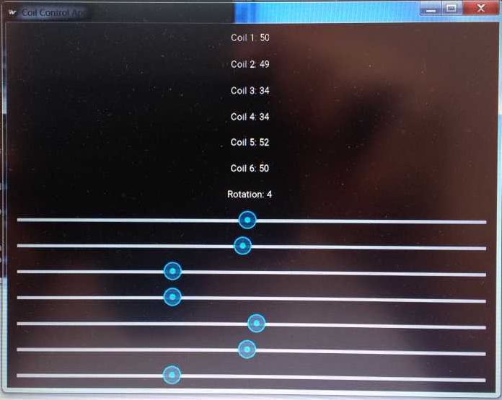
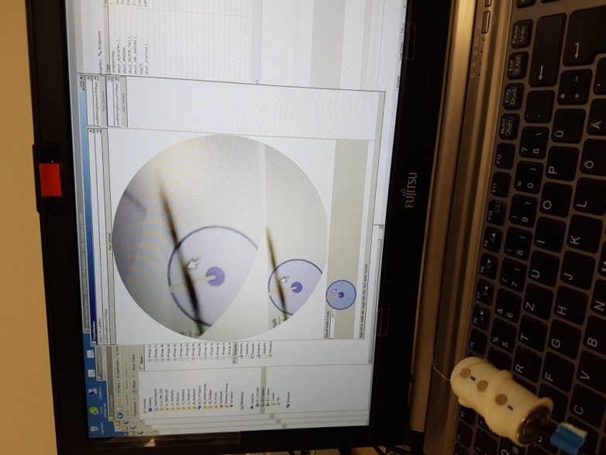
(6.5) MOMo Software
MOMo – Tkinker GUI
Control of each TAPAS Board with sliders in a Python Tkinker GUI (A)
One can set the current or rotate the B field
USB-Endoscope
Read-out via Windows driver (B)
A
B

Slide 27
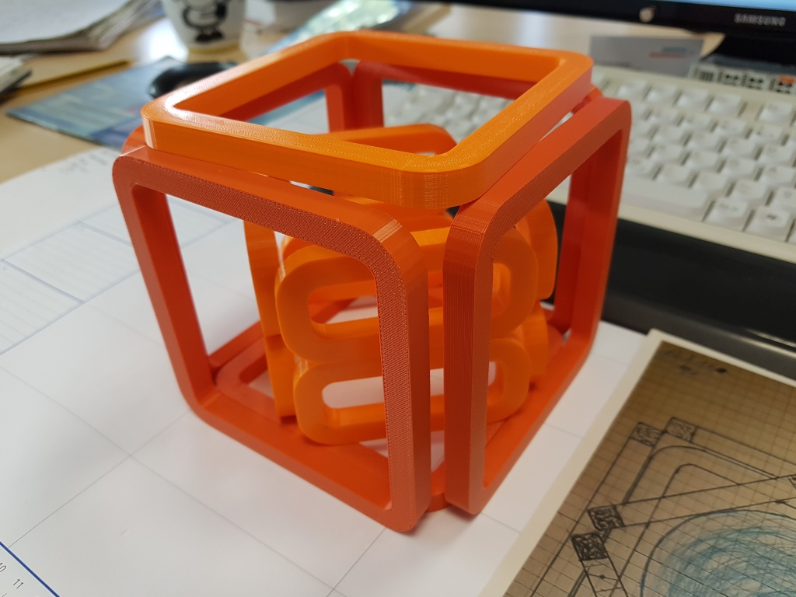
(7.1) Summary
Introduction:
Theory how to move magnetic objects.
Construction of a 2A Magnet System
New 15A Manget System with sufficient Torque
Drilling Endoscope (Rotor, USB Endoscope)
Simple 4 Coil System
Summary:
Component are available and tested
2A Coils have been produced and tested
15A Coils have been produced
New Powerful 15A Helmholtz Coil System
New TAPAS firmware is in work
Intended Experiments simple rotation and USB camera successful
Outlook
3 axis rotation with a 6 Coils Helmholtz System
Impulse Drill through a water hose

Slide 28
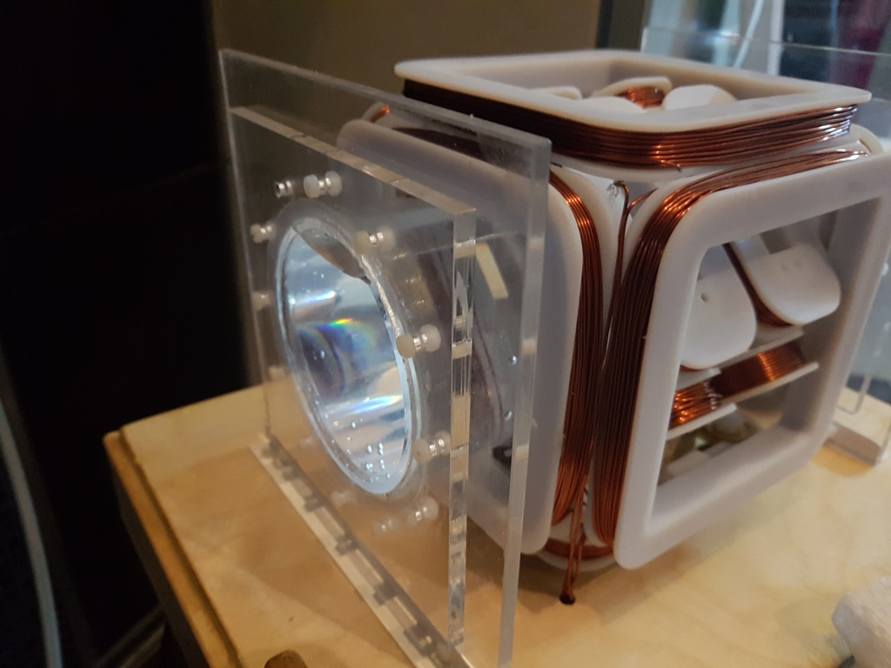
Thank you for your attention!
Dr. Martin Bräuer
Dr. Asim Araz
Klaus Hörcher
Andreas Henne

